Slide 1
@Open-Ones Group
Apply CMMI
into Software Development
Duration: 30'
Presenter: Open-Ones Group

Slide 2
Objectives
Can understand and apply some main Process Areas from CMMI into software development
  How to manage the project planning
  How to manage the project requirement
  How to manage version of source code, document
  How to make sure the product is right
  How to perform quality improvement

Slide 3
Contents
Brief in CMMI
  Project planning
  Requirements Management
  Configuration Management
  Verification
  Causal Analysis and Resolution

Slide 4
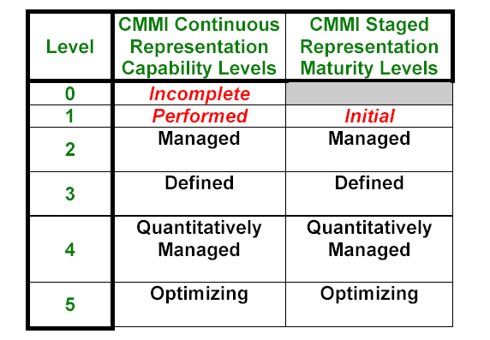
Brief in CMMi
CMMI (Capability Maturity Model Integration)
Notes:
CMMI is a process improvement maturity model for the development of products and services. It consists of best practices that address development and maintenance activities that cover the product lifecycle from conception through delivery and maintenance.
CMM to assess development and maintenance processes, implement improvements, and measure progress
CMMI provides a single framework for improvement in software engineering, systems engineering, integrated product and process development, and supplier sourcing

Slide 5
Brief in CMMi
Level | Focus | Process Area
5 Optimizing | Continuous Process Improvement | Organizational Innovation and Deployment Causal Analysis and Resolution
4 Quantitatively Managed | Quantitative Management | Organizational Process Performance Quantitative Project Management
3 Defined | Process Standard | Requirement Development Technical Solution Product Integration Verification, Validation Organizational Process Focus Organizational Process Definition Organizational Training Integrated Project Management Risk Management Decision Analysis and Resolution
3 Managed | Basic Project Management | Requirement Management Project Planning, Project Monitoring and Control Supplier Agreement Management Measurement and Analysis Process and Product Quality Assurance Configuration Management
1 Initial
Notes:
Concepts:
GP -Generic Practices: Kinh nghiệm chung
Staged approach: phương thức trưởng thành theo mức
Continuous approach: phương thức trưởng thành theo quy trình
PA-Process Area: vùng qui trình
Institutionalize: thể chế hóa

Slide 6
Process Areas
5 |  |  | Organizational Innovation & Deployment | Causal Analysis and Resolution | 5
4 |  | Quantitative Project Management | Organizational Process Performance |  | 4
3 | Validation Verification Product Integration Technical Solution Requirement Development | Risk Management Integrated Project Management | Organizational Training Organizational Process Definition Organizational Process Focus | Decision Analysis & Resolution | 3
2 | Requirement Management | Supplier Agreement Management Project Monitoring and Control Project Planning |  | Configuration Management Process and Product QA Measure & Analysis | 2
 | Engineering | Project Management | Process Management | Support
Notes:
A PA is cluster of related practices in an area that, when performed collectively, satisfy a set of goals considered important for making significant improvement in that area
Practices are actions to be performed to achieve the goals of a PA
All CMMI? PAs are common to both continuous and staged representation.
The difference between them is that:
• Process area capability (continuous) deals with a set of practices relating to a single process area, while
• organizational maturity (staged) pertains to a set of process areas across an organization.

Slide 7


1. Project Planning
Purpose: to establish and maintain plans that define project activities.
Establish and maintain estimation (SG1)
Establish and maintain a Project Plan (SG2)
Establish and maintain a Commitment to Project Plan (SG3)
Institutionalize a Managed Process (GG1)
Notes:
Specific goals and practices are specific to a process area
Generic goals and practices are a part of every process area
Each process area is defined by a set of goals and practices. These goals and practices appear only in that process area.
REQM-SP1: Requirements are managed and inconsistencies with plans and work products are identified.

Slide 8
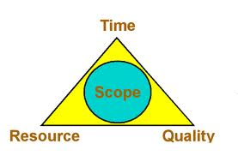

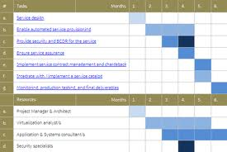

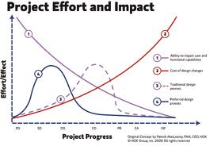
1. Project Planning
SP 1.1 | Establish the Scope of the project
 | Establish a top-level work breakdown structure (WBS) to estimate the scope of the project.
SP 1.2 | Establish Estimates of Work products Task attributes
 | Establish and maintain estimates of work product and task attributes
Planning
Data
SP 1.3 | Define Project Life Cycle
 | Define project lifecycle phases on which to scope the planning effort
SP 1.4 | Determine Estimates of Effort and Cost
 | Estimate the project’s effort and cost for work products and tasks based on estimation rationale.
SG1: Establish and maintain estimation
Estimates of project planning parameters are established and maintained

Slide 9
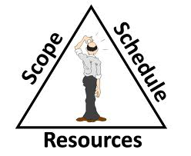
1. Project Planning
SP 2.1 | Estimate the Budget & Schedule
 | Establish and maintain the project’s budget and schedule
Project Plan
SP 2.2 | Identify Project Risks
 | Identify and analyze project risks
SP 2.3 | Plan for Data Management
 | Plan for the management of project data
SP 2.7 | Establish the Project Plan
 | Establish and maintain the overall project plan
SP 2.4 | Plan for Project Resources
 | Plan for resources to perform the project
SP 2.6 | Plan Stakeholder Involvement
 | Plan the involvement of identified stakeholders
SP 2.5 | Plan for Needed Knowledge & Skills
 | Plan for knowledge and skills needed to perform the project
SG2: Establish and maintain a Project Plan
A project plan is established and maintained as the basis for managing the project.

Slide 10



1. Project Planning
SP 3.1 | Review Plans that Affected the Project
 | Review all plans that affect the project to understand project commitments
Project Plan
SP 3.2 | Reconcile Work and Resource Levels
 | Adjust the project plan to reconcile available and estimated resources
SP 3.3 | Obtain Plan Commitment
 | Obtain commitment from relevant stakeholders responsible for performing and supporting plan execution
SG3: Obtain Commitment to the Plan
Commitments to the project plan are established and maintained

Slide 11
Work products of Project Planning
Typical Work Products
Task descriptions
Work package descriptions
WBS
Technical approach
Project lifecycle phases
Project effort estimates
Project cost estimates
Project schedules, Schedule dependencies
Project budget
Identified risks
Risk impacts and probability of occurrence
Risk priorities
Data management plan
Master list of managed data
Training plans
Overall project plan
Record of the reviews of plans that affect the project
Etc...
Implementation
Implemented Work Products
WBS Estimation
Project schedule
CM Plan
Project Plan review checklist
CM Plan review checklist

Slide 12
2. Requirements Management
Purpose: manage the requirements of the project's products and product components and to ensure alignment between those requirements and the project's plan and work products.
Manage Requirements (SG1)
Institutionalize a Managed Process (GG1)
Notes:
Specific goals and practices are specific to a process area
Generic goals and practices are a part of every process area
Each process area is defined by a set of goals and practices. These goals and practices appear only in that process area.
REQM-SP1: Requirements are managed and inconsistencies with plans and work products are identified.

Slide 13
2. Requirements Management
SP 1.1 | Understand Requirements
 | Develop an understanding with the requirements providers on the meaning of the requirements.
SP 1.2 | Obtain Commitment to Requirements
 | Obtain commitment to requirements from project participants
SP 1.3 | Management Requirements Changes
 | Manage changes to requirements as they evolve during the project
SP 1.4 | Maintain bidirectional traceability
 | Maintain bidirectional traceability among requirements and work products
Req
Plan
Design
Code
Test
SP 1.5 | Ensure products aligned with requirements
 | Ensure that project plans and work products remain aligned with the requirements
SG1: Manage Requirements

Slide 14
Work products of Requirement
Typical Work Product
List of req providers
Criteria for evaluation and acceptance
Results of analysis
Agreed set of reqs
Req impact assessments
Commitment to reqs & req changes
Req tracking system
Reqs Traceability Matrix
Documentation of inconsistencies
Details
Specified Work Product
URD
SRS
Approval evidence of SRS
Evidence of review requirement
Estimation
CR analysis record
Defect list
Test plan, Test design, Test Case
SRS Review checklist

Slide 15
3. Configuration Management
Purpose: is to establish and maintain the integrity of work products using configuration identification, configuration control, configuration status accounting, and configuration audits.
 | Establish Baselines (SG1)
 | Track and Control Changes (SG2)
 | Establish Integrity (SG3)

Slide 16

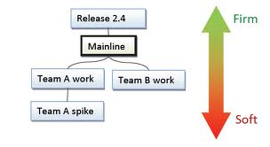
3. Configuration Management
SP 1.1 | Identify Configuration Items
 | Identify configuration items, components, and related work products to be placed under configuration management
SP 1.2 | Establish a Configuration Management System
 | Establish and maintain a configuration management and change management system for controlling work products
SP 1.3 | Create or Release Baselines
 | Create or release baselines for internal use and for delivery to the customer
How, When, Which, Where?
SG1: Establish Baselines
Baselines of identified work products are established.
Notes:
What criteria is CI selected on?
- Criteria for selecting those work products should be expanded to include anything that could impact safety, security, quality, schedule, cost, profit and the environment.

Slide 17
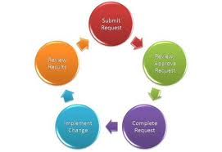

3. Configuration Management
SP 2.1 | Track Change Requests
 | Track change requests for configuration items
SP 2.2 | Control Configuration Items
 | Control changes to configuration items
How, When, Which, Where?
SG2: Track and Control Changes
Changes to the work products under configuration
management are tracked and controlled
Notes:
What criteria is CI selected on?
- Criteria for selecting those work products should be expanded to include anything that could impact safety, security, quality, schedule, cost, profit and the environment.

Slide 18


3. Configuration Management
SP 3.1 | Establish Configuration Management Records
 | Establish and maintain records describing configuration items
SP 3.2 | Perform Configuration Audits
 | Perform configuration audits to maintain the integrity of configuration baselines
How, When, Which, Where?
SG3: Establish Integrity
Integrity of baselines is established and maintained
Notes:
What criteria is CI selected on?
- Criteria for selecting those work products should be expanded to include anything that could impact safety, security, quality, schedule, cost, profit and the environment.

Slide 19
Product of Configuration Management
Typical Work Product
Identified configuration items
Conf. management system with controlled work products
Conf. management system access control procedures
Description of Baselines
Change Request
Revision history of CIs
Archives of the baselines
Status of CIs
Differences between baselines
Configuration audit results
Implemented
Specified Work Product
Process CM
CM Plan
Change Request Form
Baseline Audit report

Slide 20

4. Verification
Purpose: to ensure that selected work products meet their specified requirements
 | Prepare for Verification (SG1)
 | Perform Peer Reviews (SG2)
 | Verify Selected Work Products (SG3)
 | Institutionalize a Defined Process (GG3)

Slide 21

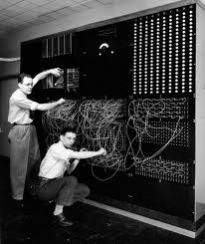

4. Verification
SP 1.1 | Select Work Products for Verification
 | Select work products to be verified and verification methods to be used
SP 1.2 | Establish the Verification Environment
 | Establish and maintain the environment needed to support verification
SP 1.3 | Establish Verification Procedures and Criteria
 | Establish and maintain verification procedures and criteria for the selected work products
QC Plan
SG1: Prepare for Verification
Preparation for verification is conducted

Slide 22


4. Verification
SP 2.1 | Prepare for Peer Reviews
 | Prepare for peer reviews of selected work products
SP 2.2 | Conduct Peer Reviews
 | Conduct peer reviews of selected work products and identify issues resulting from these reviews
SP 2.3 | Analyze Peer Review Data
 | Analyze data about the preparation, conduct, and results of the peer reviews
SG2: Perform Peer Reviews
Peer reviews are performed on selected work products

Slide 23


4. Verification - SG3
SP 3.1 | Perform Verification
 | Perform verification on selected work products
SP 3.2 | Analyze Verification Results
 | Analyze results of all verification activities
Test report
SG3: Verify Selected Work Products
Selected work products are verified against their specified requirements

Slide 24
Product of verification
Typical Work Product
Lists of work products selected for verification
Verification methods for each selected work product
Verification environment
Verification procedures
Verification criteria
Peer review schedule
Peer review checklist
Entry and exit criteria for work products
Criteria for requiring another peer review
Peer review training material
Selected work products to be reviewed
Peer review results
Peer review issues
Peer review data
Peer review data
Peer review action items
Verification results
Verification reports
Demonstrations
As-run procedures log
Analysis reports
Trouble reports
Change requests for verification methods, criteria,
and the environment
Implemented
Specified Work Product
Test Plan
CM Plan
Test case
Checklists for SRS, ADD, DDD, Project Plan
Review meeting record
Test report
Bug analysis

Slide 25

5. CAR-Causal analysis and Resolution
Purpose: is to identify causes of selected outcomes and take action to improve process performance
 | Determine Causes of Selected Outcomes (SG1)
 | Address Causes of Selected Outcomes (SG2)

Slide 26
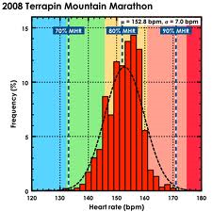
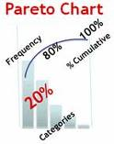
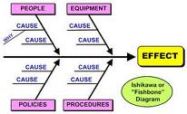
5. Causal analysis and Resolution
SP 1.1 | Select Outcomes for Analysis
 | Select Outcomes for Analysis
SP 1.2 | Analyze Causes
 | Perform causal analysis of selected outcomes and propose actions to address them
SG1: Determine Causes of Selected Outcomes
Root causes of selected outcomes are systematically determined
Notes:
What criteria is CI selected on?
- Criteria for selecting those work products should be expanded to include anything that could impact safety, security, quality, schedule, cost, profit and the environment.

Slide 27



5. Causal analysis and Resolution
SP 2.1 | Implement Action Proposals
 | Implement selected action proposals developed in causal analysis
SP 2.2 | Evaluate the Effect of Implemented Actions
 | Evaluate the effect of implemented actions on process performance
SP 2.3 | Record Causal Analysis Data
 | Record causal analysis and resolution data for use across projects and the organization
SG2: Address Causes of Selected Outcomes
Root causes of selected outcomes are systematically addressed
Notes:
What criteria is CI selected on?
- Criteria for selecting those work products should be expanded to include anything that could impact safety, security, quality, schedule, cost, profit and the environment.

Slide 28
Product of CAR
Typical Work Product
Data to be used in the initial analysis
Initial analysis results data
Outcomes selected for further analysis
Root cause analysis results
Action proposal
Action proposals selected for implementation
Action plans
Analysis of process performance and change
in process performance
Causal analysis and resolution records
Organizational improvement proposals
Implemented
Specified Work Product
CAR of coding bugs
CAR of testing bugs

Slide 29
Conclusion
The quality of a product is largely determined by the quality of the process that is used to develop and maintain it.
CMM is a goal, not a method!
A high maturity organization where all individuals recognize their role and responsibility for business success is an organization that is more likely to achieve success

Slide 30
References
CMMI® for Development, Version 1.3
http://www.sei.cmu.edu/library/abstracts/reports/10tr033.cfm
Public FPT Software's CMMI documents
http://ict-industry.gov.vn/Clients/Document/DownloadDocument.aspx?Me=Document&ID=1

Slide 31
Q&A

